Slide 2
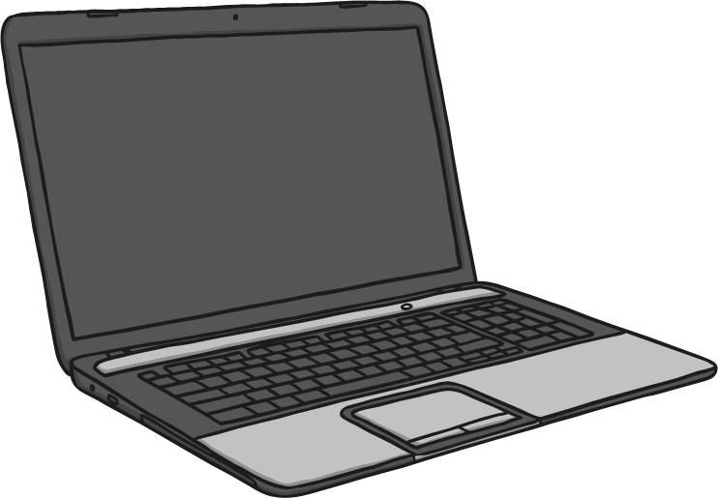
Laptop
But don’t say:
laptop
computer
internet

Slide 3
Lamp
But don’t say:
lamp
light
lampshade

Slide 4
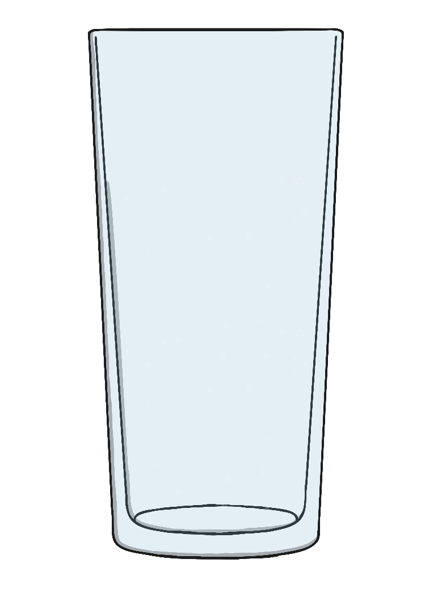
Glass
But don’t say:
glass
drink
water

Slide 5
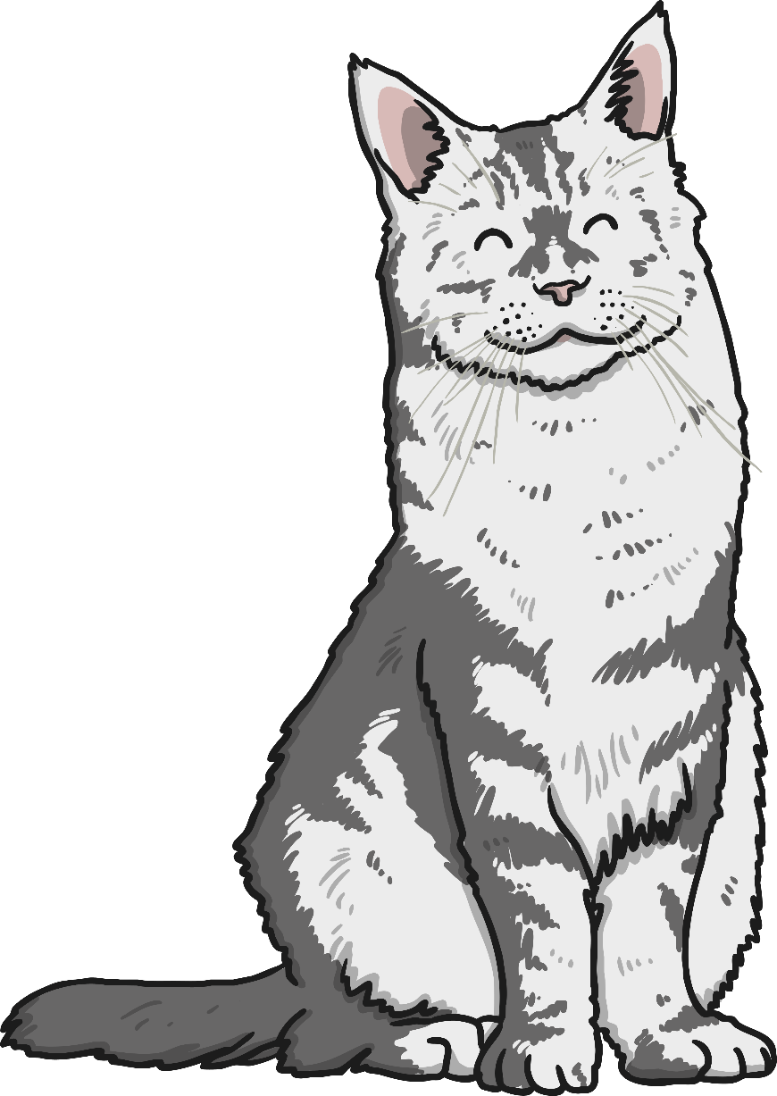
Cat
But don’t say:
cat
kitten
feline

Slide 6
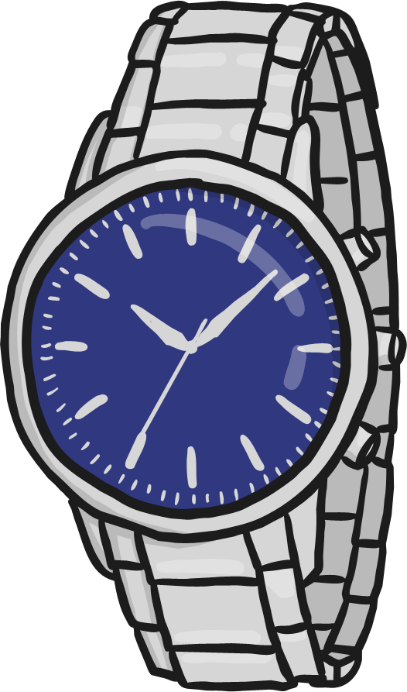
Watch
But don’t say:
watch
clock
time

Slide 7
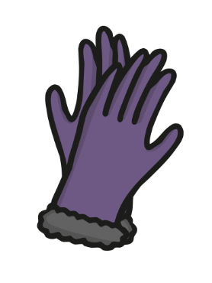
Gloves
But don’t say:
gloves
mittens
hands

Slide 8
Fireplace
But don’t say:
fireplace
fire
fantelpiece

Slide 9
Leprechaun
But don’t say:
leprechaun
St. Patrick’s Day
pot of gold

Slide 10
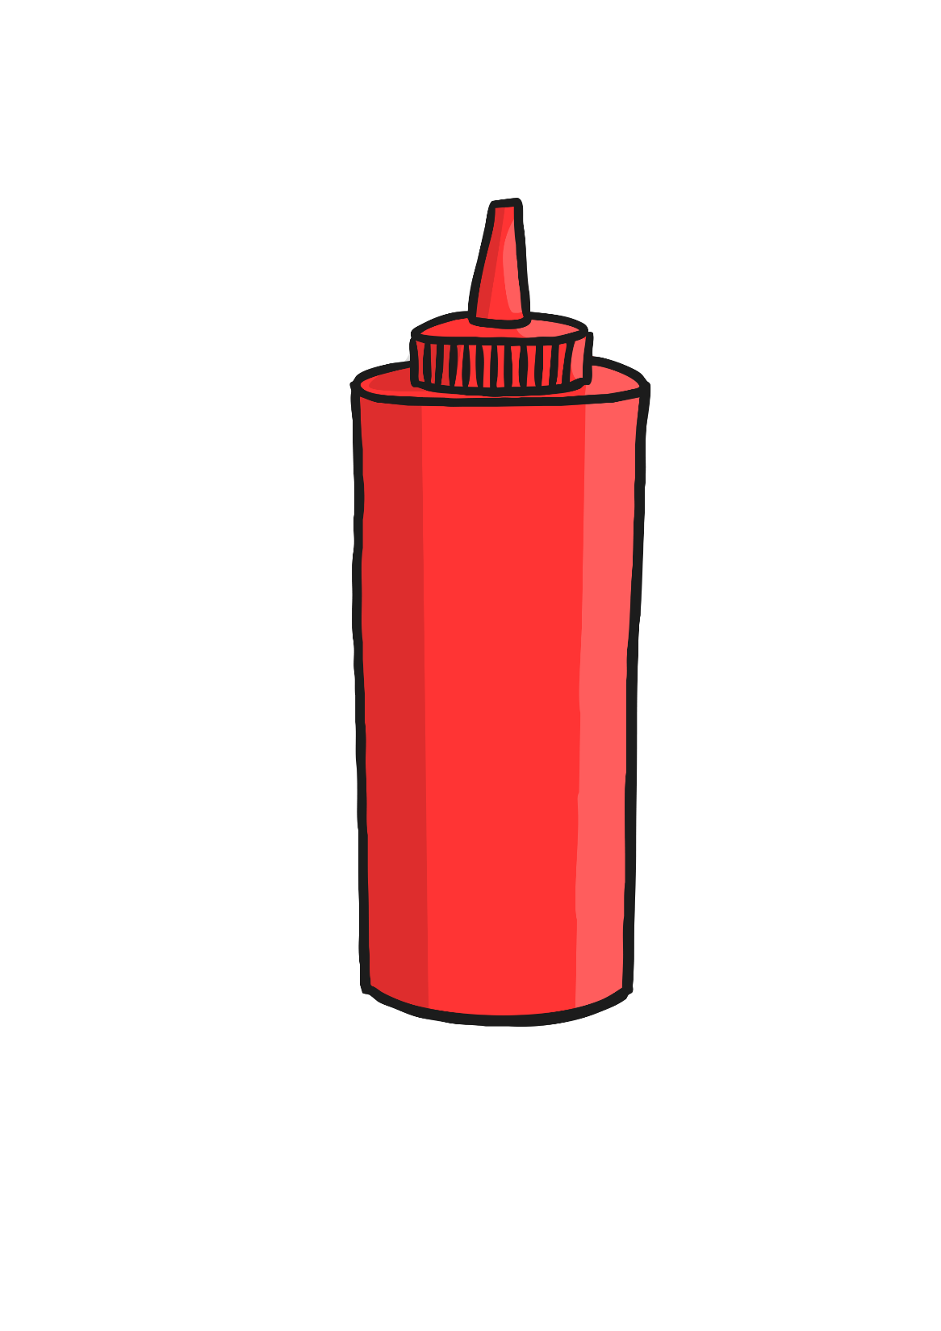
Ketchup
But don’t say:
ketchup
tomato
chips

Slide 11
Glasses
But don’t say:
glasses
eyes
see

Slide 12
Book
But don’t say:
book
read
novel

Slide 13
Jigsaw
But don’t say:
jigsaw
puzzle
game

Slide 14
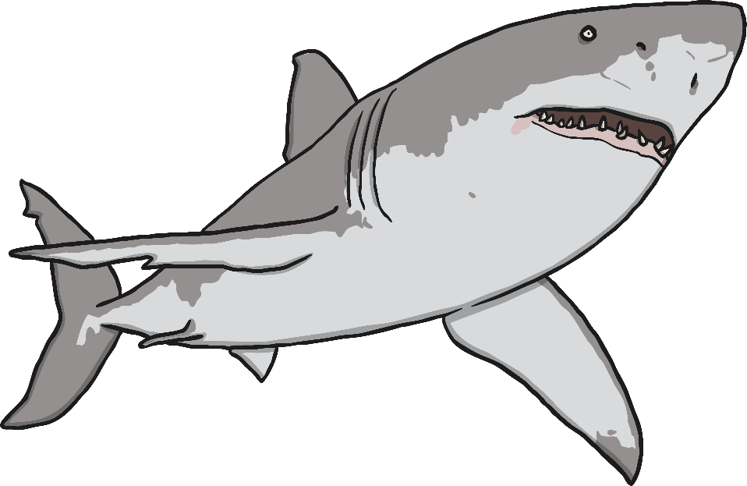
Shark
But don’t say:
shark
sea
dangerous

Slide 15
Window
But don’t say:
window
glass
open

Slide 16
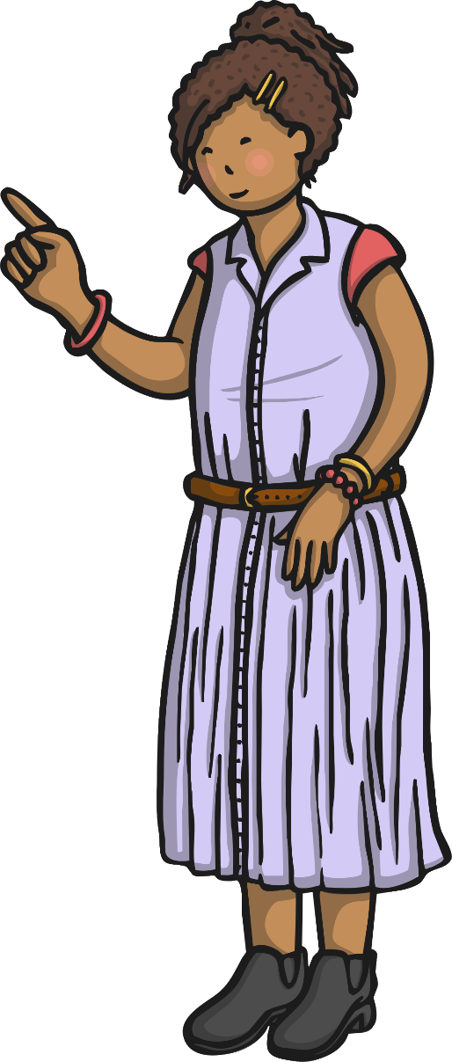
Teacher
But don’t say:
teacher
school
class

Slide 17
Belt
But don’t say:
belt
waist
trousers

Slide 18
Coins
But don’t say:
coins
money
metal

Slide 19
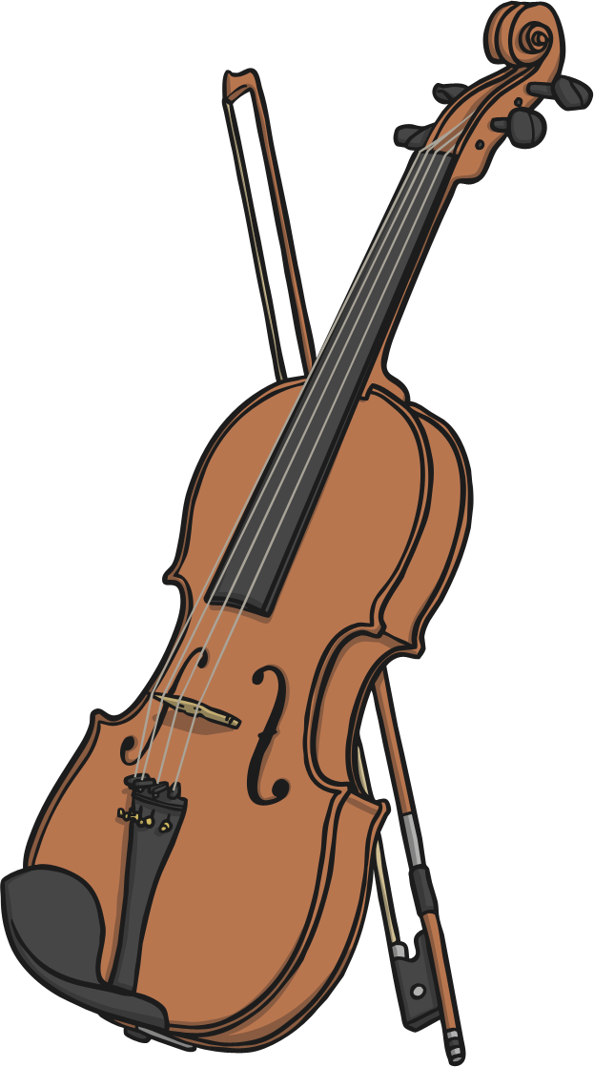
Violin
But don’t say:
violin
fiddle
music

Slide 20
Nose
But don’t say:
nose
face
smell

Slide 21
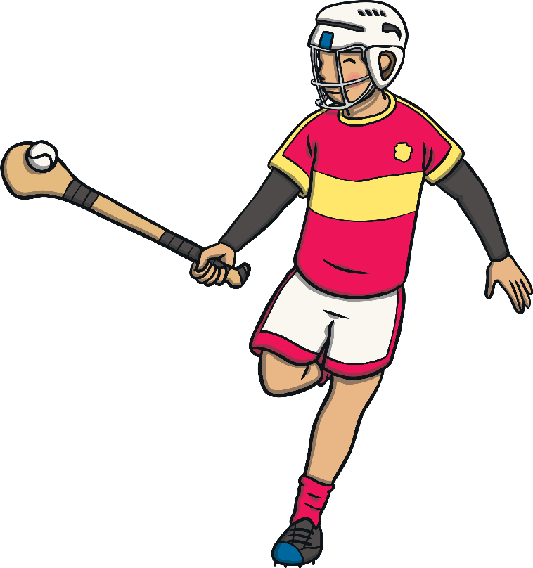
Hurling
But don’t say:
hurling
hurl
sliotar

