Slide 2
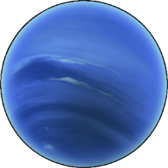
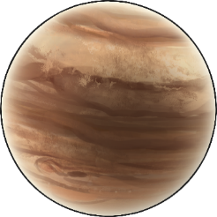
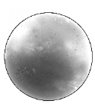
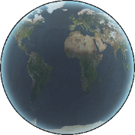
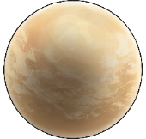
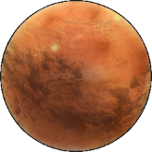
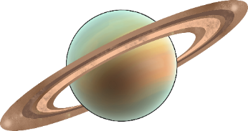
Earth is only one of the planets in our solar system. There are seven other planets that also orbit our Sun.
Neptune
Jupiter
Mercury
Earth
Uranus
Venus
Mars
Saturn

Slide 3
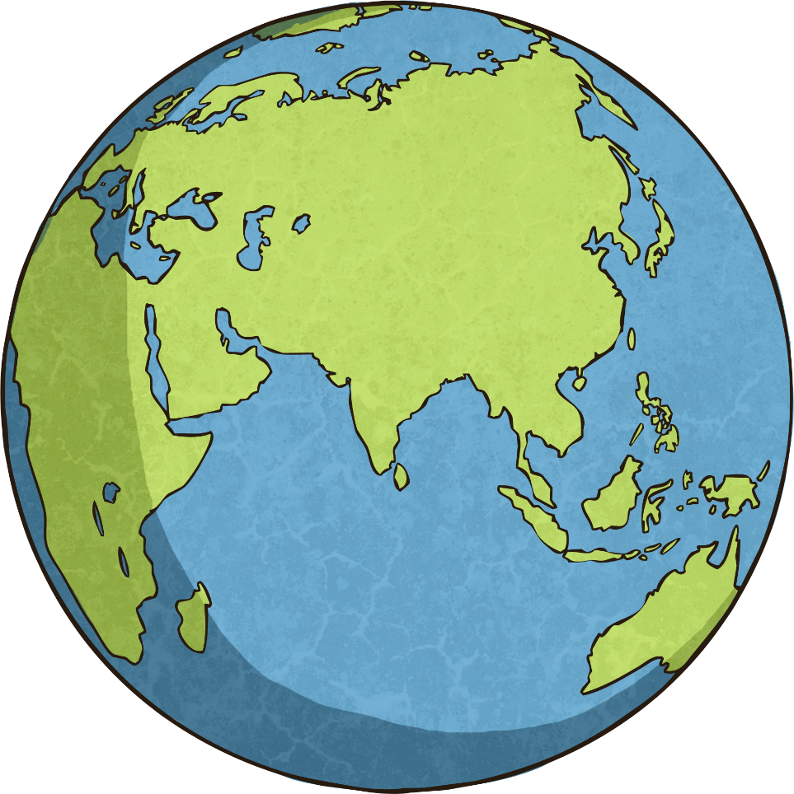
Our Home Planet
Earth, our home planet, is the third planet from the Sun and the fifth largest planet in the Solar System. Earth is 150 million kilometres from the Sun.

Slide 4
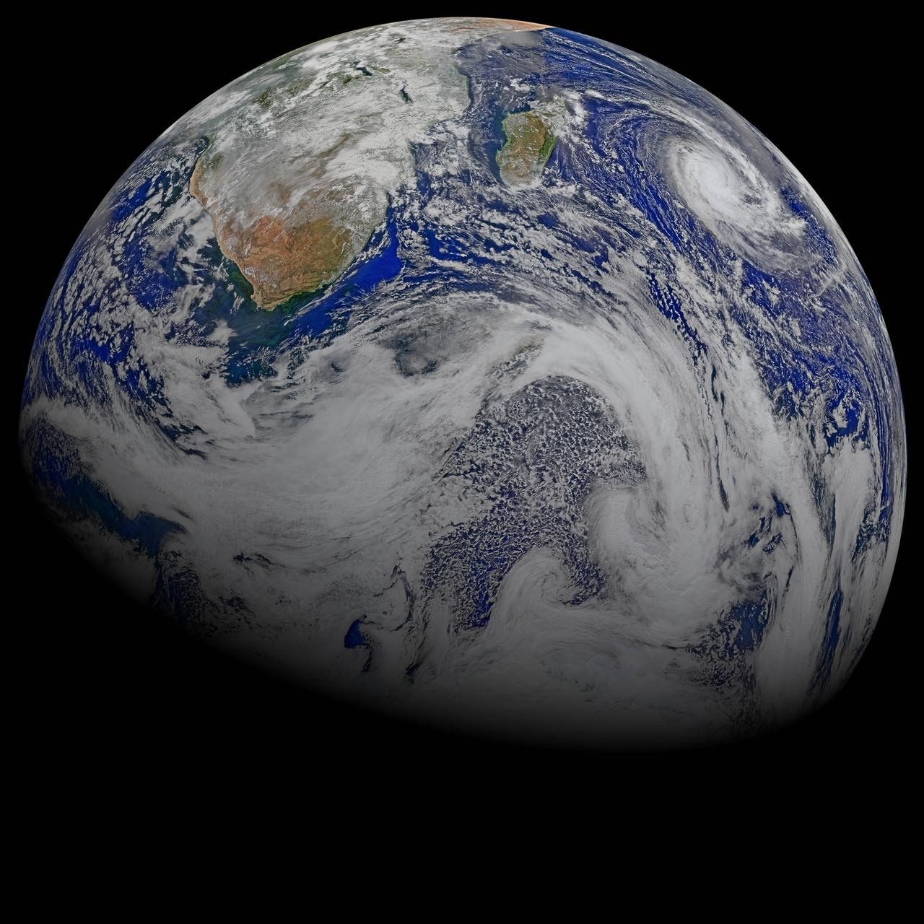
It takes the Earth 24 hours to rotate once.
A complete orbit of the Sun takes 365.25 days. Our calendars count a year as being 365 days. The extra 0.25 of a day is counted as an extra day every four years; a ‘leap year’.
The Earth is at a slight tilt, meaning parts of the Earth are closer to the Sun at different times of the year. It is this tilt that causes the four seasons.
“A Sky View of Earth From Suomi NPP” by NASA Goddard Space Flight Center is licensed under CC BY 2.0

Slide 5
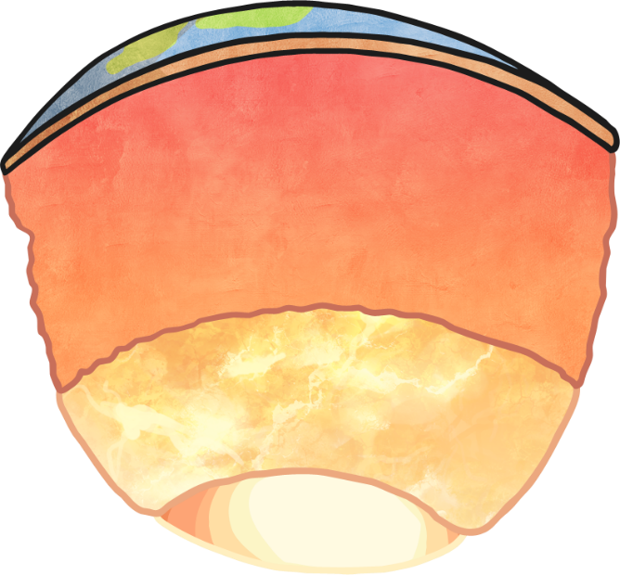
The Earth is the only planet in the Solar System to have water on its surface.
Liquid water covers over 70% of the total surface of the planet.
The centre of the Earth is made of a hot metal core, surrounded by a liquid metal outer core, a mantle of molten rock and a rocky crust on the outside.

Slide 6
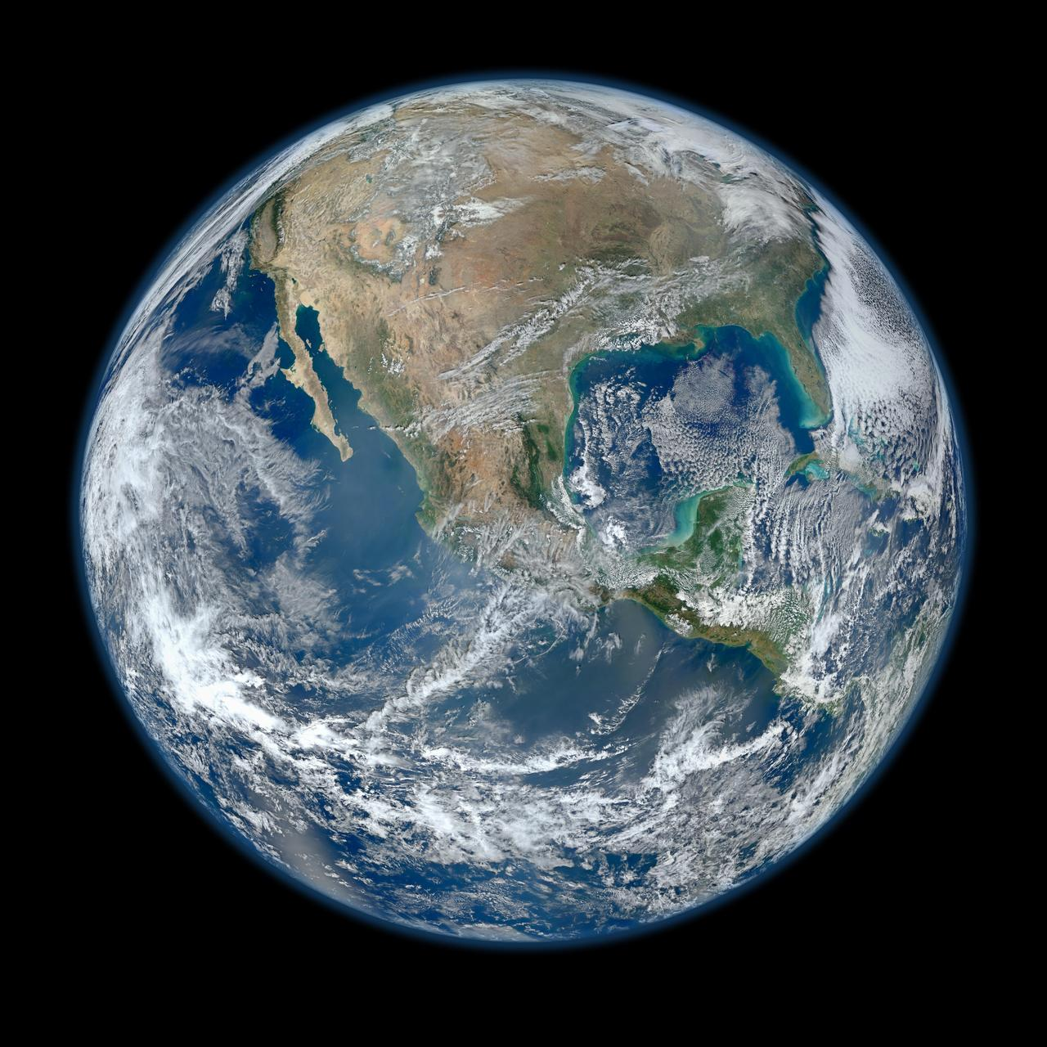
The Earth has a variety of landscapes, including mountains, volcanoes, deserts, arctic, grasslands and valleys.
The surface of the Earth is split into different sections called tectonic plates. These plates are constantly moving, in some areas by about approximately 5 to 10cm every year.

Slide 7
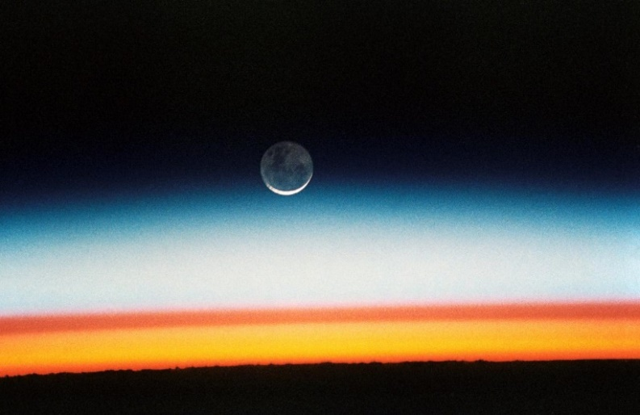
Exploring
The atmosphere of the Earth is made up of a mixture of gases;
78% nitrogen
21% oxygen
1% other gases (such as argon, carbon dioxide and neon).
The atmosphere of Earth affects the climate around the world and also burns up some of the harmful radiation that comes from the Sun and some meteors in the sky before they can reach the ground.
“Sunrise, Earth Limb” by NASA Goddard Space Flight Center is licensed under CC BY 2.0

Slide 8
It is not known for sure how ‘Earth’ got its name.
One theory is the name came from Old English and German words ‘eorthe’ and ‘erde’ meaning ‘ground’, but that is not for certain.
Earth is the only planet in the Solar System that is not named after a Greek or Roman god or goddess.

Slide 9
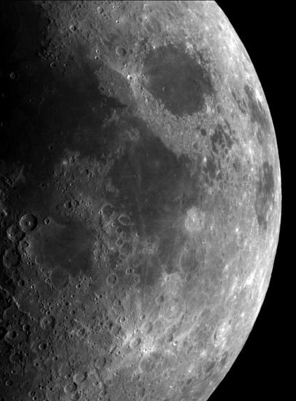
The Earth has one moon.
It is largely known as ‘the Moon’, however it is also known by its Latin name, ‘Luna’, which is where the adjective ‘lunar’ comes from.
The Moon is 384,400 kilometres away from Earth. That means you could fit 30 Earth-sized planets in between Earth and the Moon!
The Moon is the only place humans have set foot aside from the Earth.
“Earth - Moon Conjunction” by NASA Goddard Space Flight Center is licensed under CC BY 2.0

Slide 10
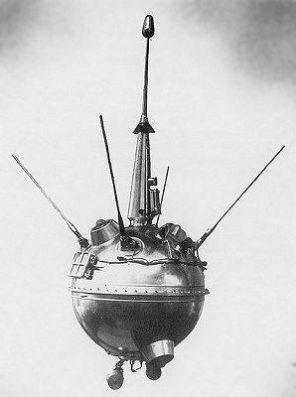
Moon Exploration
Humans have studied Earth’s moon for thousands of years.
It is the most explored body in our Solar System apart from Earth, having been visited by numerous spacecraft.
The first spacecraft to touch the surface of the Moon was the unmanned Soviet probe ‘Luna 2’ in 1959. It crashed into the surface as it was designed to in order to test whether the Moon’s craters contained ice.

Slide 11
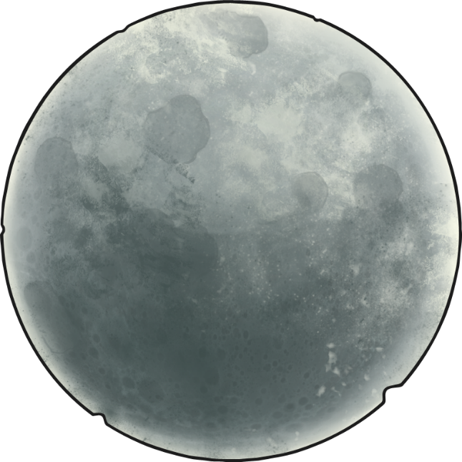
Moon Exploration
After the success of Luna 2, the Soviet Space program sent many more spacecraft to the Moon.
The first to successfully land intact on the surface was Luna 9 in 1966. The same year, Luna 10 became the first man-made object to orbit the Moon.
After the success of Luna 2, the Soviet Space program sent many more spacecraft to the Moon.
The first to successfully land intact on the surface was Luna 9 in 1966. The same year, Luna 10 became the first man-made object to orbit the Moon.

Slide 12
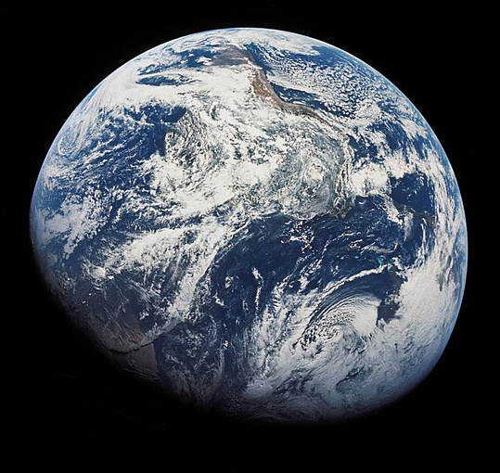
Moon Exploration
In 1968, Apollo 8 became the first manned spacecraft to orbit the moon.
Astronauts Frank Borman, James Lovell and William Anders became the first humans to travel beyond Earth’s orbit and see our home planet as a whole.
During their mission, they were able to make observations of the Moon’s surface and take photographs, including the very first photograph of Earth from a distance.

Slide 13
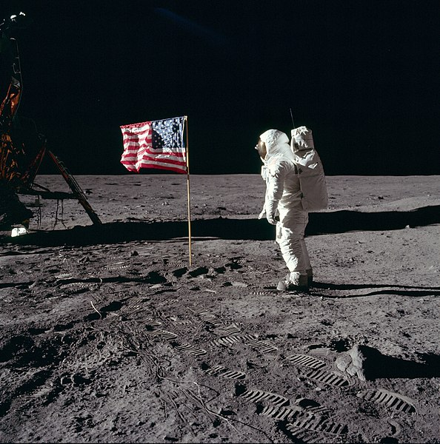
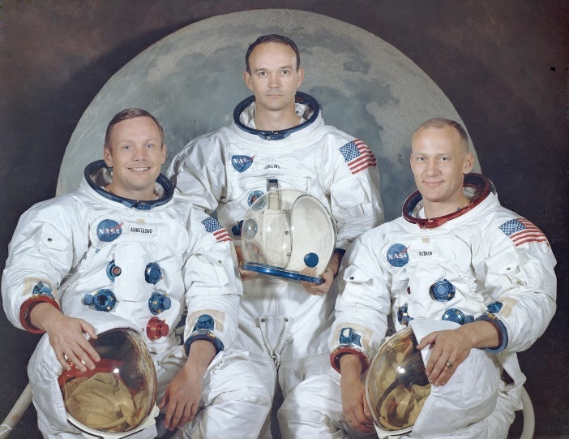
Moon Exploration
NASA spacecraft Apollo 11 arrived in orbit around the Moon on July 19th 1969 in preparation for landing on the Moon’s surface. On board were three astronauts; Neil Armstrong, Edwin “Buzz” Aldrin and Michael Collins.
On July 24th, the lunar module successfully landed and Armstrong became the first man to walk on the Moon.
While on the surface, Armstrong and Aldrin collected samples of moon rock, took photos and planted an American flag.
“Saturn Apollo Program” by NASA Goddard Space Flight Center is licensed under CC BY 2.0

Slide 14
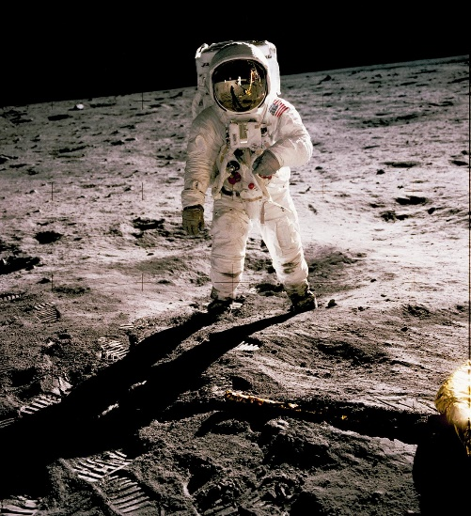
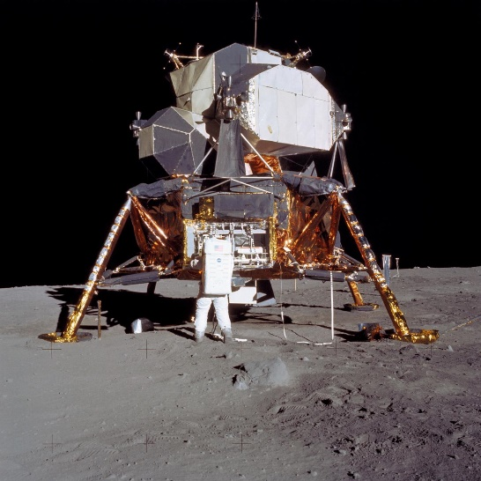
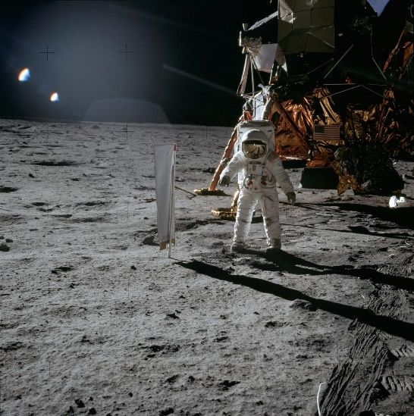
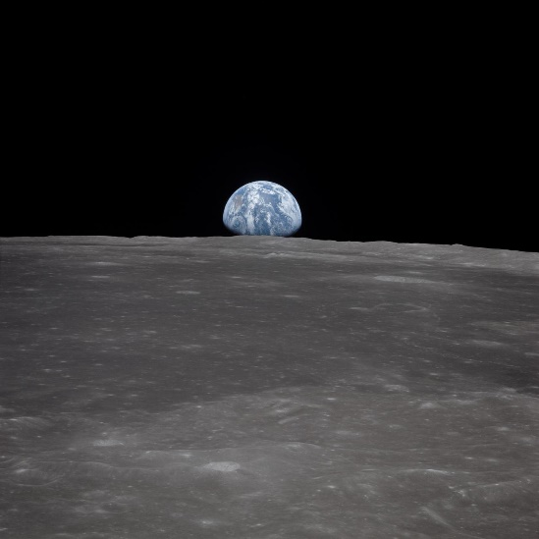
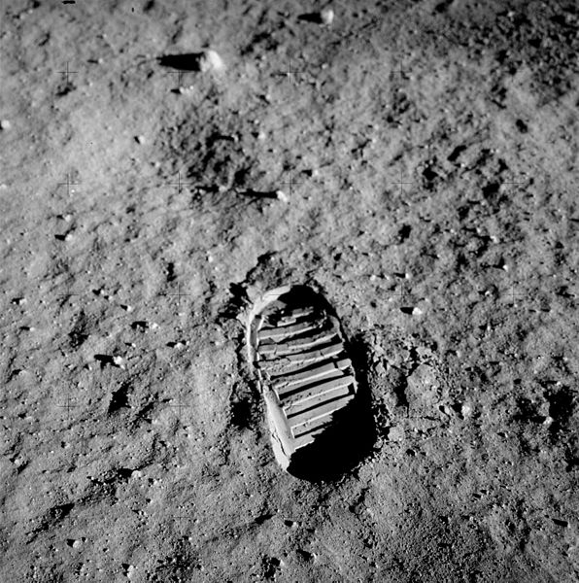
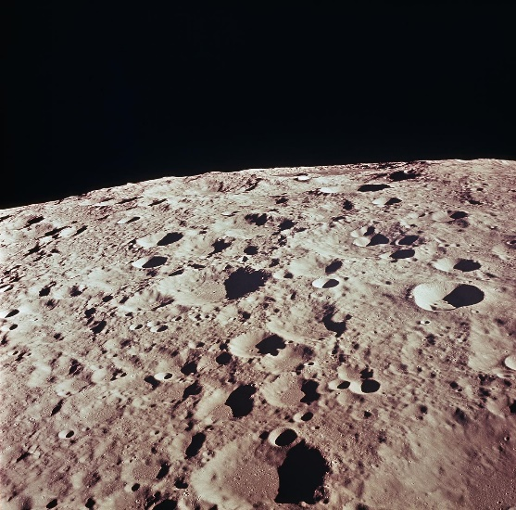
Photographs of the Moon

