Slide 2
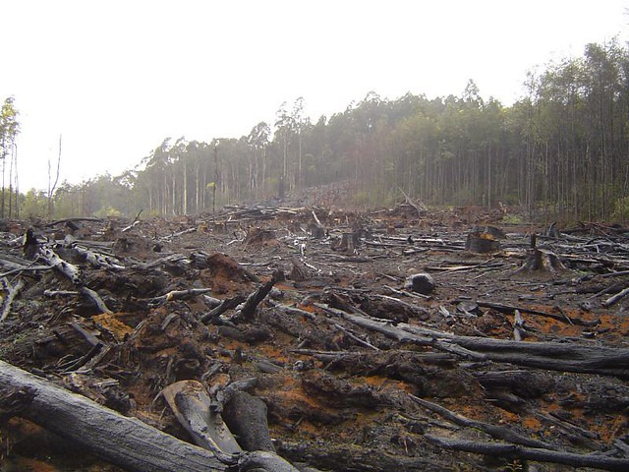
What Is Deforestation?
Deforestation is the act of clearing away many trees by cutting or burning.
It is usually done in order to make way for growing crops or farming cattle, for building roads or towns, or to make use of the wood.

Slide 3
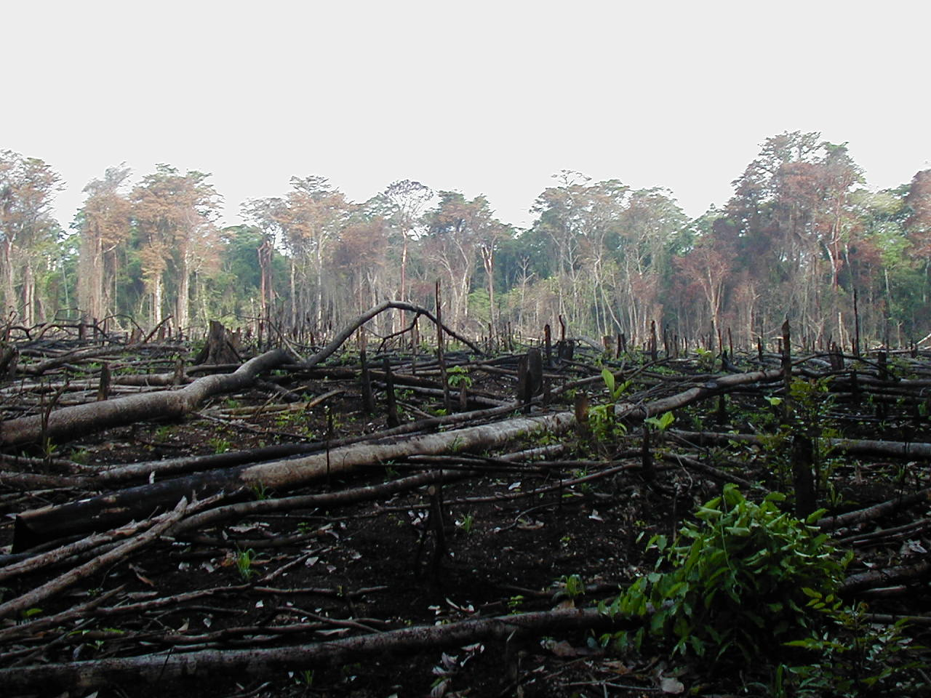
What Is Deforestation?
Trees are useful and valuable.
What things can you find in the room that rely on trees being cut down?
Woods like teak and mahogany are strong and are perfect for making furniture or building. Many of these unique tree species grow in tropical rainforests like the Amazon in South America and are cut down so that the wood can be sold. This is called logging.

Slide 4
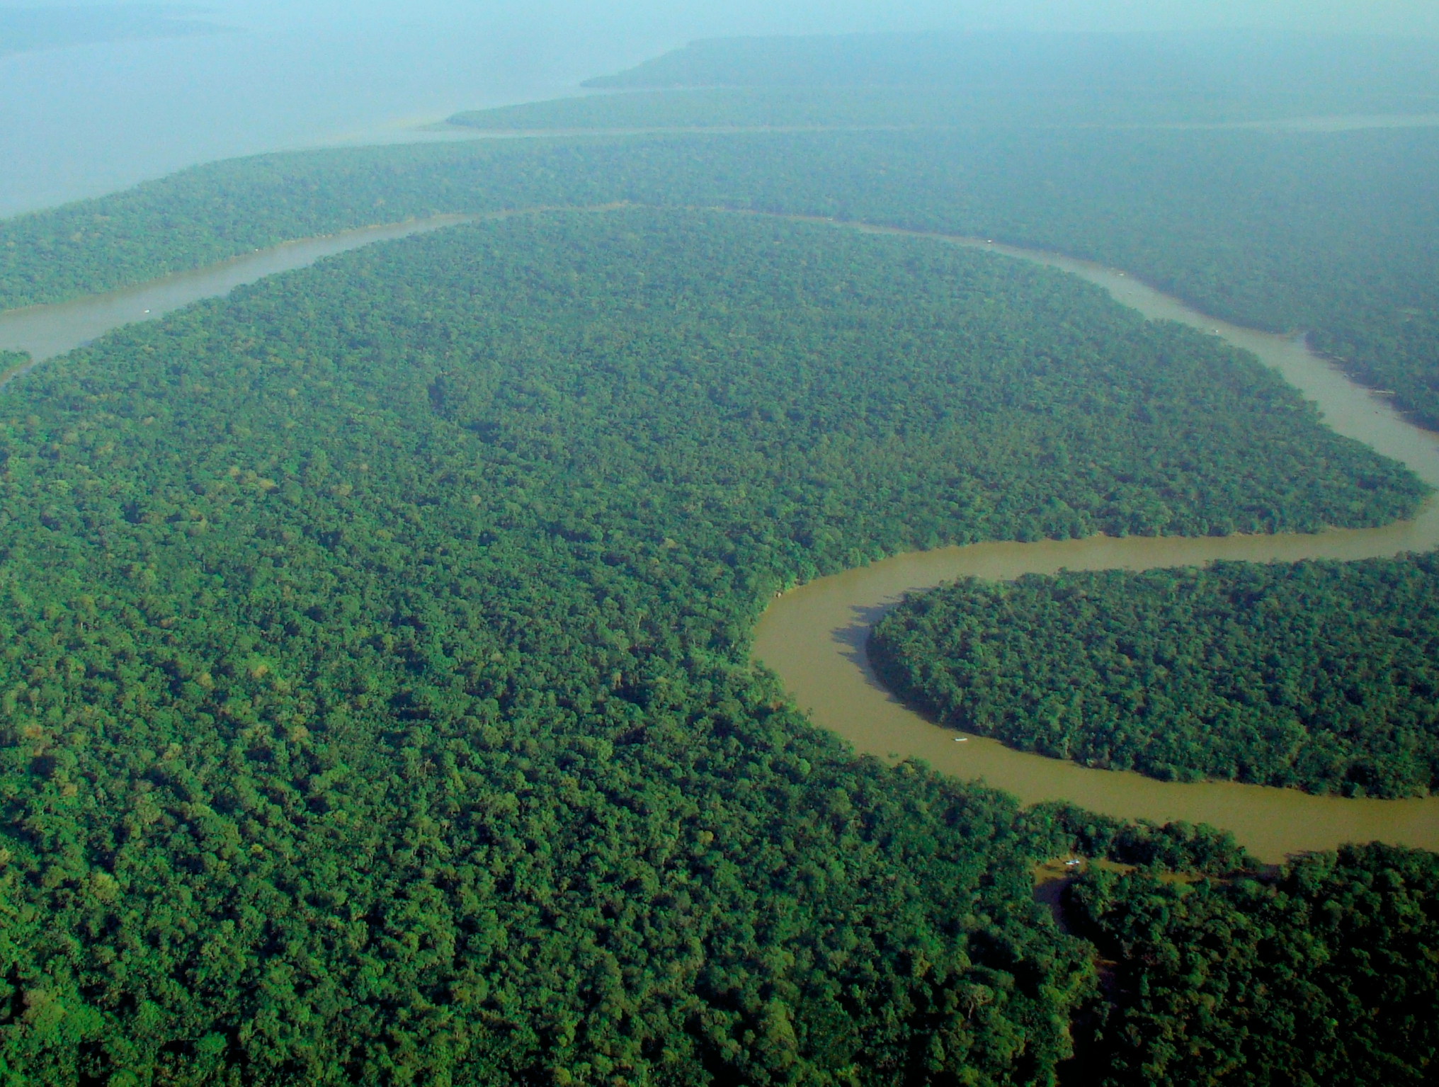
Deforestation in the Amazon Rainforest
The Amazon rainforest is the world’s largest tropical rainforest. It is so big that the UK and Ireland would fit inside it seventeen times.
The rainforest is home to 390 billion trees (16,000 species) and 10% of all animal species in the world live there. There are at least 40,000 different plant species in the Amazon rainforest.

Slide 5
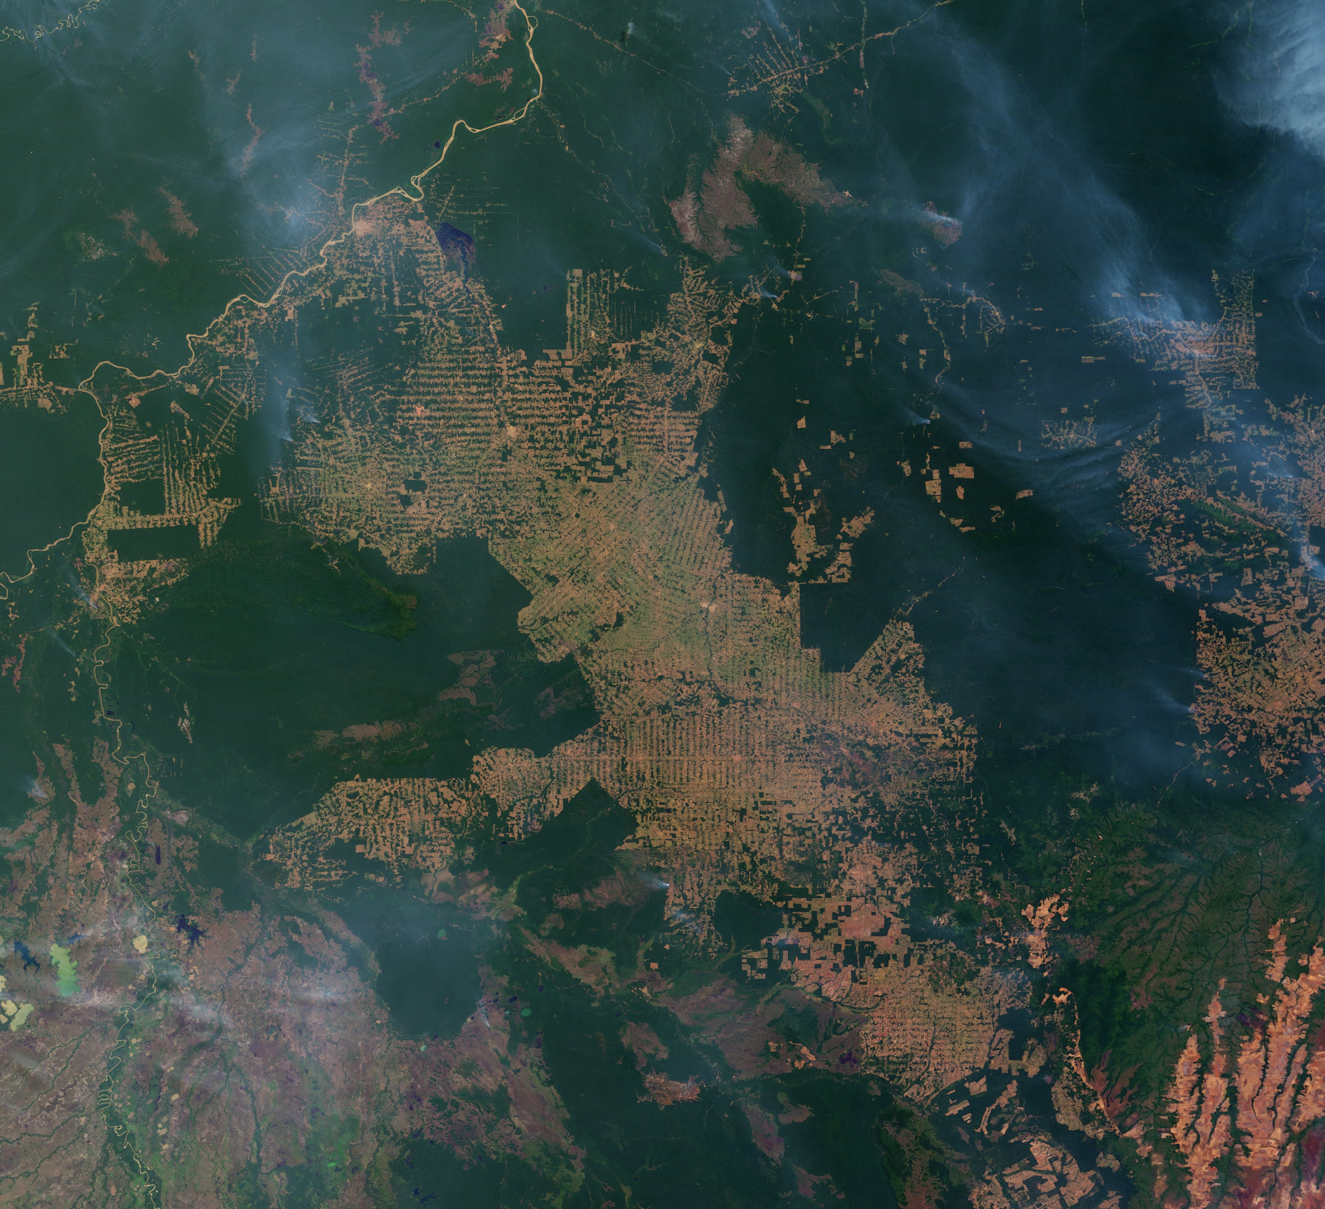
Deforestation in the Amazon Rainforest
Humans are the biggest threat to the Amazon rainforest.
More than five billion trees are cut down across the tropics every year, according to a study published in 2015.
This number increases every year and over half of the tropical forests worldwide have been destroyed since the 1960s.

Slide 6
Deforestation in the Amazon Rainforest
These are the main causes of deforestation in the Amazon rainforest.
Cause of deforestation | Percentage of deforestation caused
Cattle ranching | 65-70%
Agriculture (growing crops) | 25-30%
Logging | 2-3%
Fires, mining, building, road creation, dams | 1-2%
Cattle ranching produces beef and leather among other products.
Logging usually results in ‘degradation’, not deforestation, meaning that specific types of tree are cut down and the forest can no longer provide certain fruit, leaves, habitats, etc. for its ecosystems.

Slide 7
The Deforestation Debate: Against
Deforestation destroys the habitats of lots of animals, many of which are becoming extinct as they don’t live anywhere else.
We get a lot of our food from the rainforest, such as banana, coffee, rice, potatoes, nuts, oranges and figs. Without the forest, these will not be found in nature.
The trees help to control the climate and water cycle. Without the trees, the ‘greenhouse effect’ will be worsened and the rivers in South America could change beyond recognition.
With no trees to anchor it down, loose soil is being washed into rivers and polluting them with silt.
Even if trees are replanted, they take years to grow back, especially hardwoods.
Other animals also eat the foods found only in the forest so by cutting down these trees we are destroying both their food and ours.
A lot of logging is done illegally, in areas where cutting down the forest is not permitted.
The machinery used in deforestation also adds to carbon emissions.

Slide 8
Now, let’s see the other side of the deforestation debate...

Slide 9
The Deforestation Debate: For
Making use of the rainforest provides the human race with fuel, wood, paper, land for farming, space for mining and areas for cattle ranching.
Rainforest wood is relied upon by many people for building. Also, things made from wood like mahogany can be exceptionally beautiful.
Many governments of poorer countries around the world depend on the money made by the logging industry, as well as the trade of the goods mentioned.
Although many foods come from the rainforest, we are able to grow some of them outside of the forest, in greenhouses and plantations.
Industries that remove trees from the rainforest, such as farming or logging, can provide work for people.
Extreme weather and climate change could destroy the forest eventually anyway; it makes sense to make use of its resources now, before it is too late.
Where trees have been cut down, new ones can be replanted.
There are special, protected areas of the rainforest where cutting down trees is not permitted.

Slide 10
Are you for or against deforestation in the Amazon rainforest? Can you explain why?

